Slide 1
Food Deserts in Norfolk, VA
Charles Anthony Robinson
JUNE 2020

Slide 2
Understanding Food Deserts
What is a food desert:
The USDA defines a food desert as a low-income census tract where a substantial number or share of residents has low access to a supermarket or large grocery store.
New Market Tax Credits from the Treasury Department define which tracts are low-income.
Low-access in urban areas is defined as 33% or 500 residents in a census tract are more than 1 mile from a supermarket or large grocery store.

Slide 3
Who needs to know?
Stakeholders in this information include:
Civic leaders
Business leaders
Community organizers
All of these groups need to know where these areas are in order to better plan for the benefit of their citizens and potential customers.

Slide 4
Data Gathering and Cleaning
Census tract polygonal definitions gathered from hrgeo.org
NMTC tract specification downloaded from cdifund.gov
List of geographic residential information data.Norfolk.gov
Grocery store/Supermarket locations pulled from foursquare API
Extraneous fields were dropped, and functional data combined for mapping

Slide 5
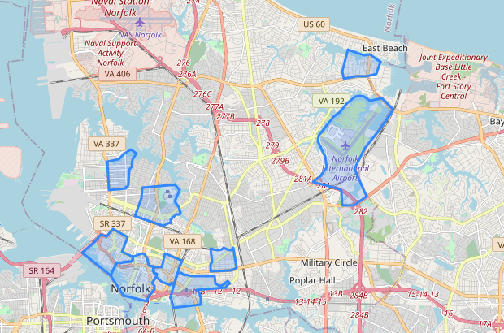
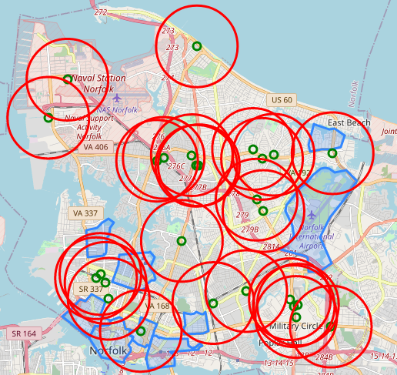
Mapping Data
NMTC tracts were mapped (above) and grocery stores with a 1-mile radius were mapped in relationship to tracts (right).

Slide 6
Analyzing the Map
Four tracts are not completely covered by the radius circles.
One of these is the airport with no residential addresses.
That leaves three to explore.

Slide 7
Putting the Data Together
Tract Name | Tract # | Total Residences | No. Outside Radius | Percentage
BRAMBLETON (SOUTH), NSU | 47 | 494 | 19 | 3.846154
NORTH COLLEY | 26 | 894 | 206 | 23.042506
PARK PLACE (EAST) | 29 | 1710 | 154 | 9.005848
The above chart indicates the number and percentage of residents outside the 1-mile radius.

Slide 8
CONCLUSION
Norfolk is fairly well laid out in terms of access to grocery stores.
North Colley and Park Place (East) are potential areas of concern.
The data only indicates number of residences, not residents.
These two areas could potentially benefit from a new source for fresh food.

